Slide 1
Lecture 9: Floorplan – I
Tsung-Wei (TW) Huang
Department of Electrical and Computer Engineering
University of Utah, Salt Lake City, UT

Slide 2
Physical Design Flow

Slide 3
Floorplanning
I/O Pads
Floorplan
Module a
Module b
Block a
Block c
Module c
Floorplanning
GND
VDD
Block d
Block Pins
Module d
Block b
Block e
Module e
Partitioned modules (e.g., FM algorithm)
Supply Network

Slide 4
Floorplanning Problem
The floorplanning problem is to plan the positions and shapes of the modules at the beginning of the design cycle to optimize the circuit performance…
chip area
total wirelength
delay of critical path
routability
others, ex: noise, heat dissipation, …

Slide 5
Floorplanning Example
Given three blocks with the following potential widths & heights
Block A: w = 1, h = 4 or w = 4, h = 1 or w = 2, h = 2
Block B: w = 1, h = 2 or w = 2, h = 1
Block C: w = 1, h = 3 or w = 3, h = 1
Goal: Pack a floorplan with minimum total area enclosed
B
C
C
A
B
A
B
Floorplanning
C
A
A

Slide 6
Floorplanning Problem Formulation
Input:
n Blocks with areas A₁, ... , A_{n}
Bounds r_{i} and s_{i} on the aspect ratio of block B_{i}
Output:
Coordinates (x_{i}, y_{i}), width w_{i} and height h_{i} for each block such that h_{i} w_{i} = A_{i} and r_{i} ≤ h_{i}/w_{i} ≤ s_{i}
Objective:
To optimize the circuit performance

Slide 7
Bounds on Aspect Ratio
If there is no bound on the aspect ratios, can we pack everything tightly?
But we don’t want to layout blocks as long strips, so we require r_{i} ≤ h_{i}/w_{i} ≤ s_{i} for each i
Floorplanning

Slide 8
Bounds on Aspect Ratio (cont’d)
In practice, we allow several shapes for soft blocks
For hard blocks, the orientations can be changed
E.g., rotate by 90 degree

Slide 9
Wirelength Estimation
Exact wirelength of each net is unknown until routing
Gate-to-gate connection is routed/established via “wire”
Some possible wirelength estimations:
Center-to-center estimation
Half-perimeter wirelength (HPWL) estimation
Center-to-center
Half-perimeter wirelength

Slide 10
Dead Space
Dead space is the space that is wasted
Minimizing area is the same as minimizing dead space
Dead space percentage is computed as
(A - Σ_{i}A_{i}) / A × 100%
Dead space (while space)

Slide 11
Objective Function
A commonly used objective function is a weighted sum of area (or dead space area) and wirelength
cost = αA + βL
A is the total area of the packing
L is the total wirelength
α and β are tuning parameters

Slide 12
Slicing Floorplan
Slicing floorplan
One that can be obtained by repetitively subdividing (slicing) rectangles horizontally or vertically
Non-slicing floorplan
One that may not be obtained by repetitively subdividing alone
Slicing floorplans are much easier to handle
Efficient data structures exist for efficient computational manipulations
Slicing Floorplan
Non-slicing Floorplan

Slide 13
Representation of Slicing Floorplan
Slicing Floorplan
Slicing Tree
V
Q: Is slicing tree unique?
3
1
H
H
4
5
2
1
H
3
2
V
V
6
7
Polish Expression: Postorder traversal of the slicing tree
6
7
4
5
21H67V45VH3HV

Slide 14
Slicing Tree is NOT Unique
Two possible slicing trees representing the same floorplan
V
V
c
H
H
H
H
b
e
f
a
b
c
H
Alternatively …
a
b
d
H
a
d
d
V
c
V
e
f
e
f

Slide 15
Polish Expression
Succinct representation of slicing floorplan
Roughly specifying relative positions of blocks
Postorder traversal of slicing tree algorithm (recursive)
1. Call postorder traversal of left sub-tree
2. Call postorder traversal of right sub-tree
3. Print the label of the current root
For n blocks, a Polish Expression contains n operands (blocks) and n-1 operators (H, V)
However, for a given slicing floorplan, the corresponding slicing tree (and hence polish expression) is not unique. Therefore, there is some redundancy in the representation

Slide 16
Redundancy of Polish Expression
Recall that the slicing tree representation is not unique
V
V
3
1
H
H
H
H
4
5
2
1
H
3
2
1
V
H
V
V
6
7
V
3
2
6
7
6
7
4
5
4
5
21H67V45VH3HV
21H67V45V3HHV

Slide 17
Skewed and Normalized Slicing Tree
Skewed Slicing Tree: no node and its right son are the same
Normalized Polish Expression: no consecutive H’s or V’s
Skewed slicing tree
(also normalized)
Not normalized!
V
V
3
1
H
H
H
H
4
5
2
1
H
3
2
1
V
H
V
V
6
7
V
3
2
6
7
6
7
4
5
4
5
21H67V45VH3HV
21H67V45V3HHV

Slide 18
Normalized Polish Expression
There is a 1-1 correspondence between Slicing Floorplan, Skewed Slicing Tree, and Normalized Polish Expression
Can we use Normalized Polish Expression (NPE) to represent slicing floorplans?
What is a valid NPE?
We formulate as a state space search problem

Slide 19
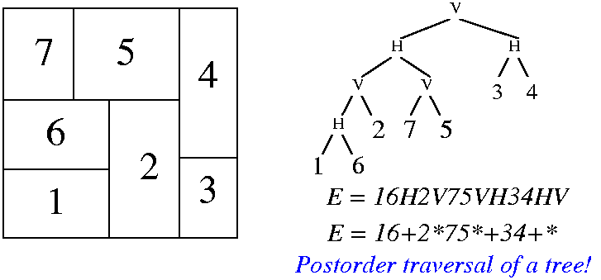
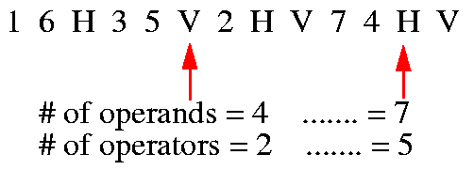
Solution Representation
An expression E = e₁e₂…e_{2n-1}, where e_{i} ∈ {1, 2, …, n, H, V}, 1≤i ≤2n-1, is a valid Polish expression of length 2n-1 if
every operand j, 1 ≤ j ≤n, appears exactly once in E;
for every sub-expression E_{i} = e₁…e_{i}, 1≤ i ≤2n-1, #operands > #operators.
Polish expression ↔ Postorder traversal.
ijH: i below j; ijV: i on the left of j.

Slide 20
Example
12VH3: invalid
123VH: valid
1234567HHHHVV: valid
1HVVHHV743526: invalid

Slide 21
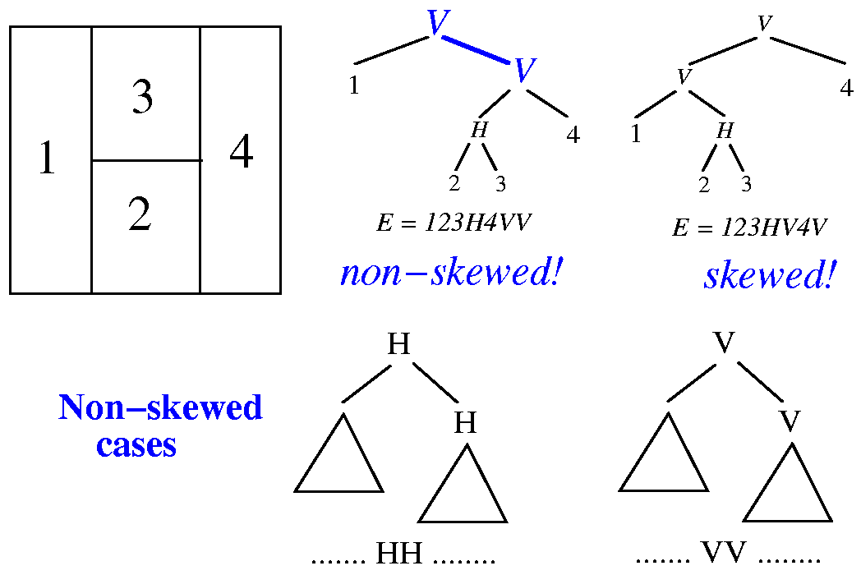
How to Remove Redundant Rep?

Slide 22
Neighborhood Structure
Chain: HVHVH… or VHVHV…
The moves:
M1: Swap adjacent operands (ignoring chains)
M2: Complement some chain
M3: Swap 2 adjacent operand and operator
M3 can give you some invalid NPE. Checking for validity after M3 is needed
It can be proved that every pair of valid NPE are connected
16H35V2HV74HV
Chains

Slide 23
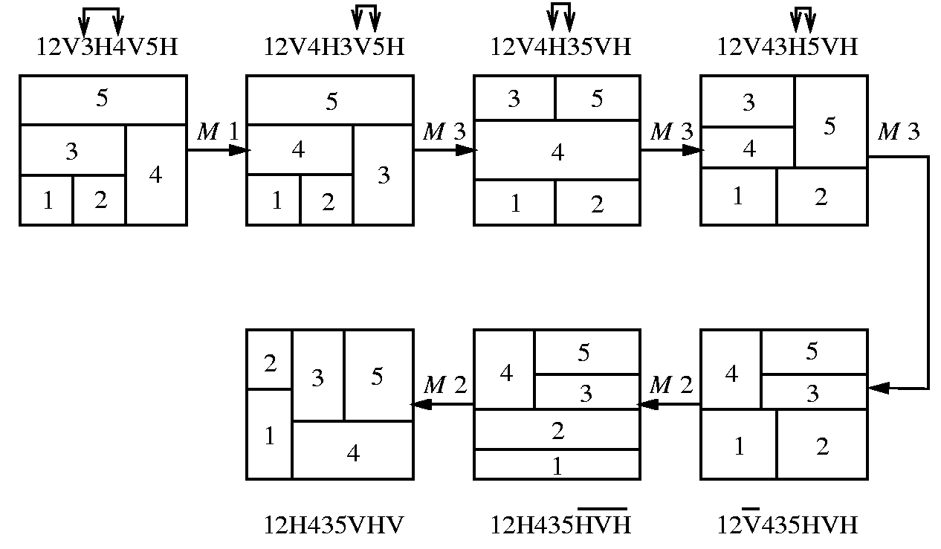
Example of Moves
1
Each move gives a new floorplan result
Key idea: try out many moves and acquire the best solution?
1
M1
2
4
5
5
3
4
3
2
34V2H5V1H
32V4H5V1H
M3
1
1
4
5
5
M2
3
2
3
2
4
32V45VH1H
32V45HV1H

Slide 24
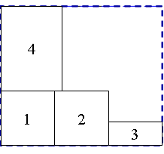
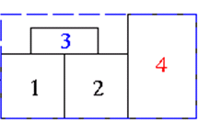
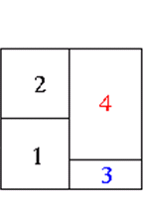
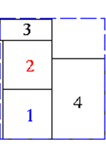
Example of Moves (cont’d)
Optimal result is acquired after three moves, M1, M2, and M3
M1
12V4H3V
12V3H4V
Initial State
M1
M2
New solution 1
M2
New solution 2
Can we solve this systematically?
M3
M3
New solution 2
…
12H34HV
12H3H4V

Slide 25
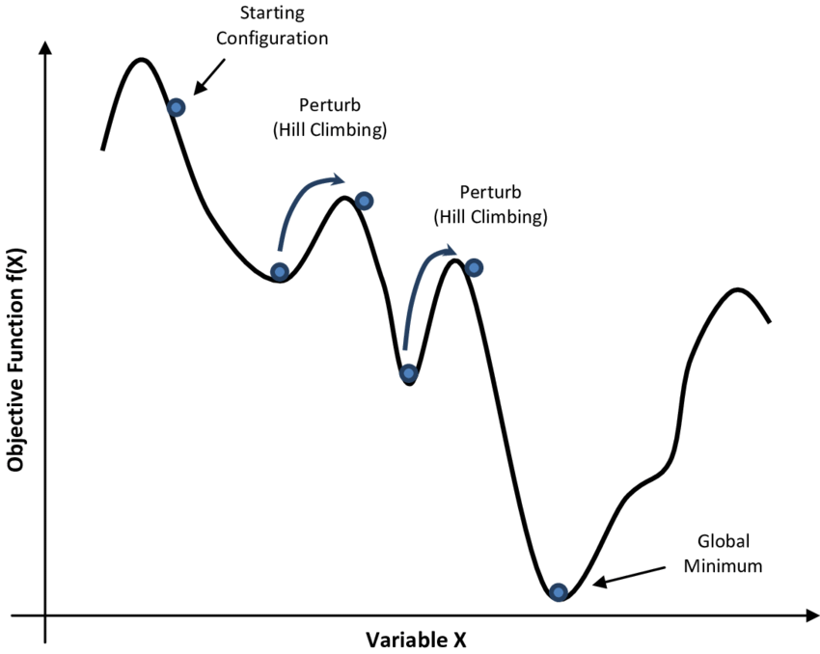
Simulated Annealing (SA) Algorithm
1 begin
2 Get an initial solution S;
3 Get an initial temperature T > 0;
4 while not yet “frozen” do
5 for 1 i P do
6 Pick a random neighbor S’ of S;
7 △← cost(S’) – cost(S); /* down hill move */
8 if △ 0 then S←S’ /* uphill move */
9 if △ > 0 then S←S’ with probability;
10 T←rT ; /* reduce temperature */
11 return S
12 end
cost (S)
State S

Slide 26
SA-based Floorplan Optimization
T_{i} = αT_{i-1} where α=0.85
At each temperature, try k × n moves
k is around 5 to 10
Terminate the annealing process if
either # of accepted moves < 5%
or the temperature is low enough
Cost metric: αA + βL
Area + Wirelength
Initial State: 1V2V3V…nV
2
3
....
n
1

Slide 27
Result of SA-based Floorplan

Slide 28
How Do We Know the Area from a PE?
Binary operator: V and H
V: maximum on width and summation on height
H: maximum on height and summation on width
W₁₂
2
W₃₄
H
H₁₂
V
1
H₃₄
3
1
2
4
3
4
W₁₂= max(W₁ , W₂)
H₁₂= H₁ + H₂
W₃₄ = W₃ + W₄
H₃₄ = max(H₃ , H₄)
(a) Postfix expression: 12H
(b) Postfix expression: 34V

Slide 29
Recover Area Recursively
Binary operator: V and H
V: maximum on width and summation on height
H: maximum on height and summation on width
Bottom-up merging left and right subtrees
W₁₂₃₄
V
2
H₁₂₃₄
H
V
1
3
4
1
2
3
4
W₁₂₃₄ = W₁₂ + W₃₄
H₁₂₃₄ = max(H₁₂ , H₃₄)
(c) Postfix expression: 12H34VV

Slide 30
Recover Area Recursively (cont’d)
Binary operator: V and H
V: maximum on width and summation on height
H: maximum on height and summation on width
Bottom-up merging left and right subtrees
W₁₂₃₄
H
3
4
H
V
2
H₁₂₃₄
1
2
3
4
1
(d) Postfix expression: 12H34VH
W₁₂₃₄ = max(W₁₂ + W₃₄)
H₁₂₃₄ = H₁₂ + H₃₄

Slide 31
Implementation using Stack
Very similar to the parathesis checking problem
Modification
V/H: pack the top-two blocks (subtrees) vertically/horizontally
https://www.geeksforgeeks.org/check-for-balanced-parentheses-in-an-expression/

Slide 32
How can We Handle Non-Slicing Tree?
Extend NEP to include pre-defined non-slicing block
d
H
b
e
g
V
H
c
a
f
H
W
h
i
H
h
i
a
b
c
d
e
f
g
H
Horizontal division (objects to the top and bottom)
H
W
Wheel (4 objects cycled around a center object)
Vertical division (objects to the left and right)
H
V
H

Slide 33
Summary
Floorplan problem is NP hard (difficult to solve efficiently)
How to represent it compactly is a big deal
Slicing is easier to deal with, so let’s start with it
Next lectures will cover other representations
Polish expression is an elegant slicing-tree representation
Need to be unique (NPE) to remove redundant space
Can be implemented efficient using linear-time data structure
Simulated annealing algorithm fits well to floorplan
Optimize the floorplan area and wirelength simultaneously

